Slide 1

ACT-SYS-DT weekly update - 6

Slide 2
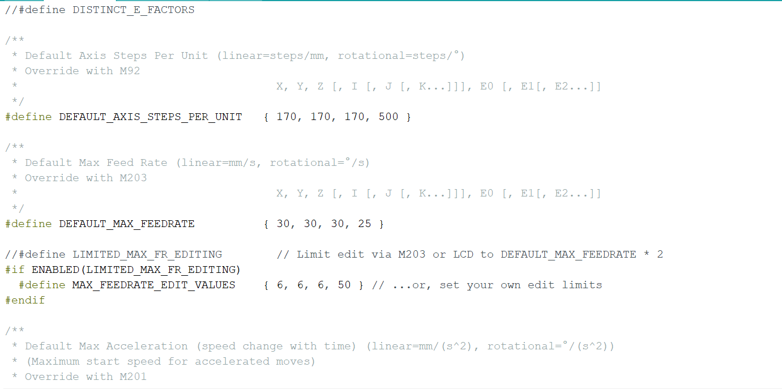
Changes made in MARLIN

Slide 3
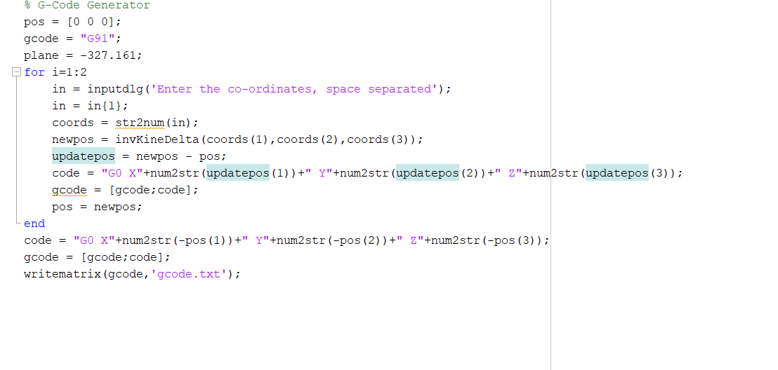
G-Code Generator

Slide 4
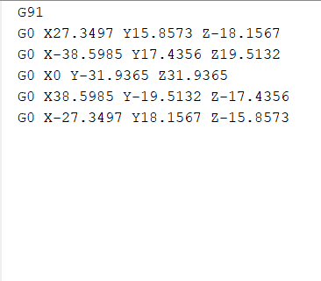
Example
100,100,-327.161
-100,100,-327.161
0,0,-327.161
-100,-100,-327.161
100,-100,-327.161

